Slide 1

#HeyBlue!
project Overview

Slide 2
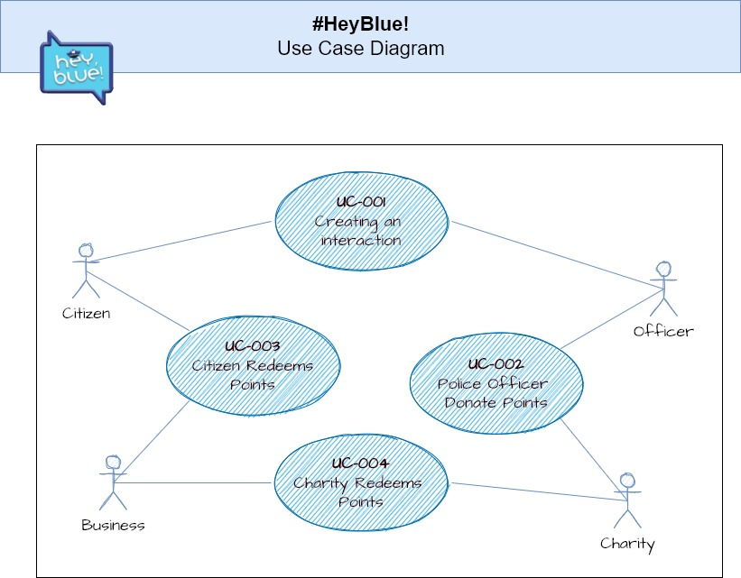
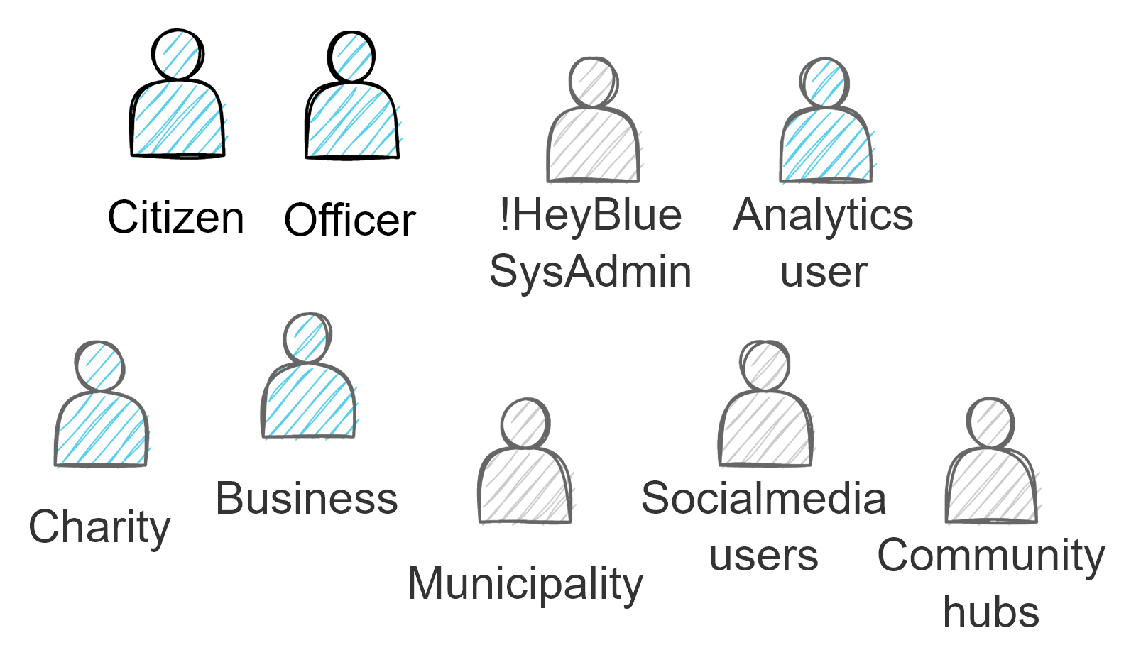
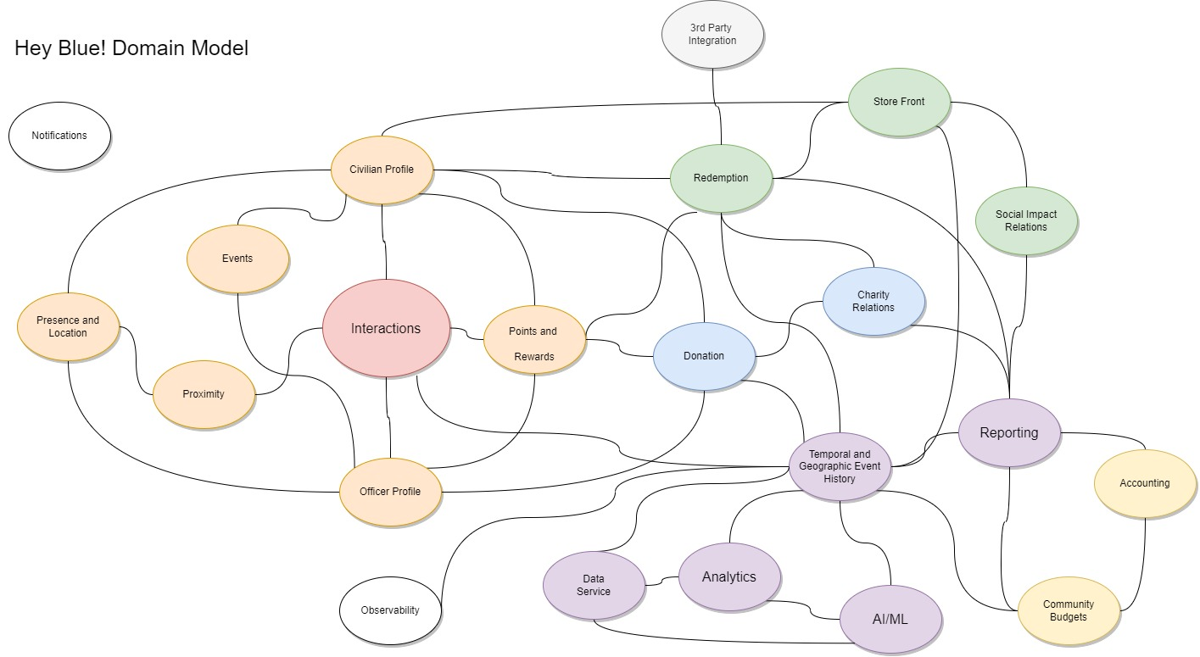
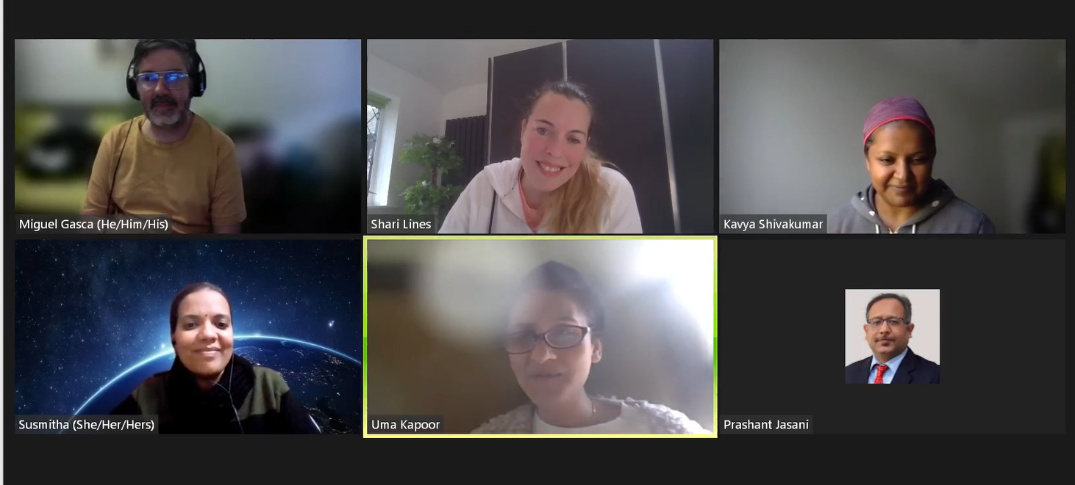
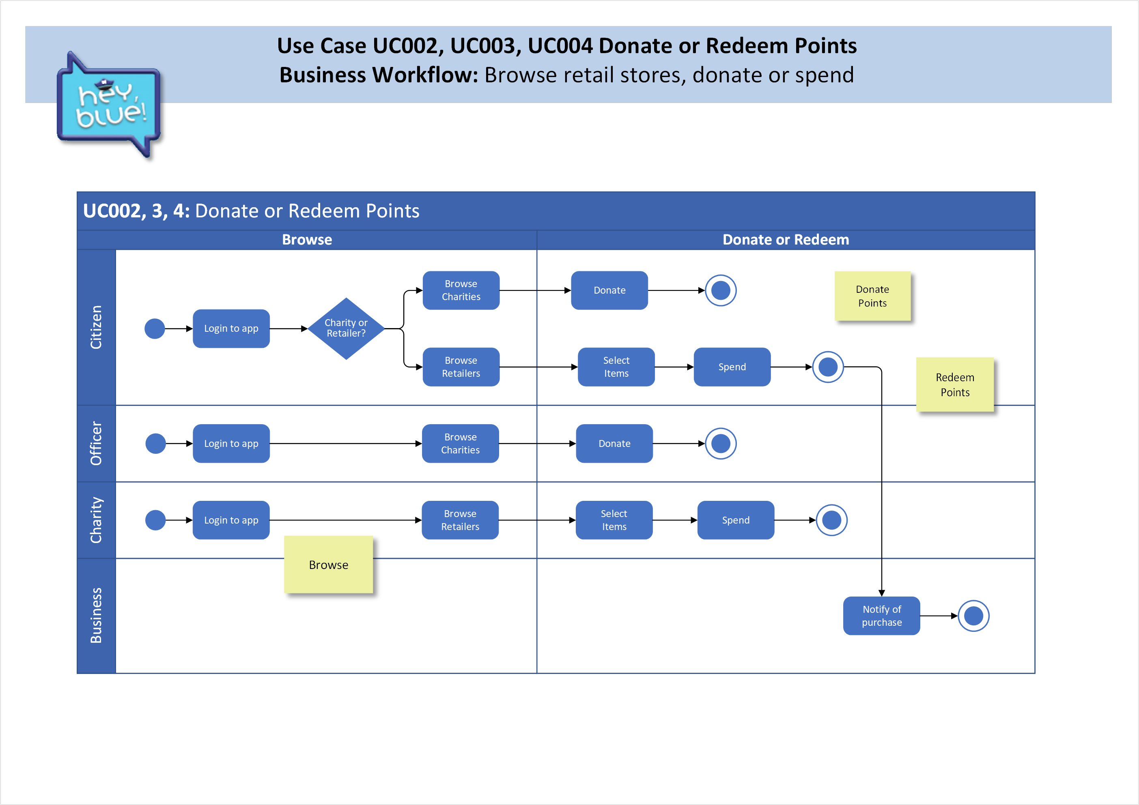
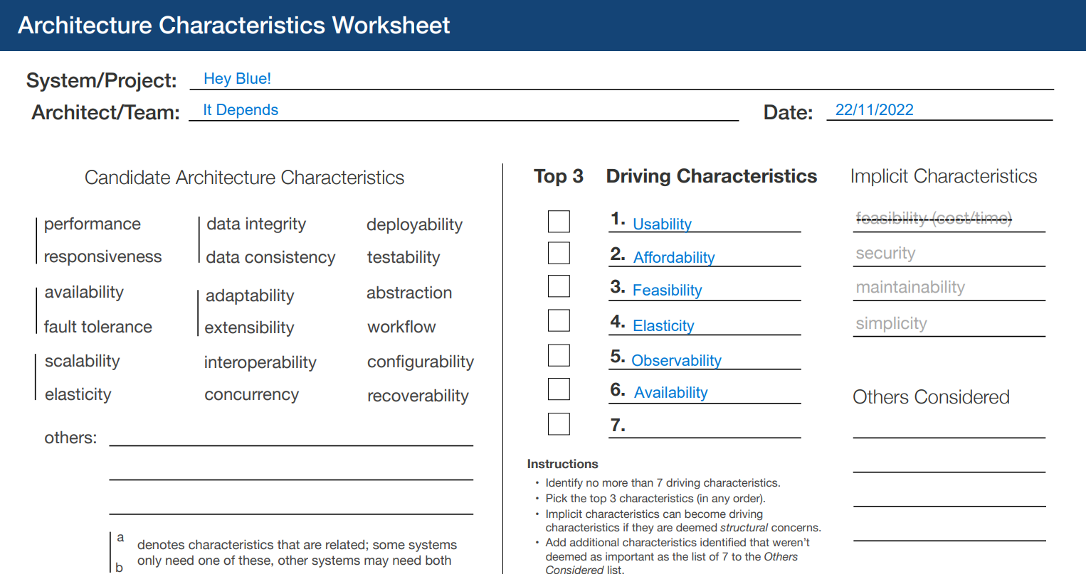
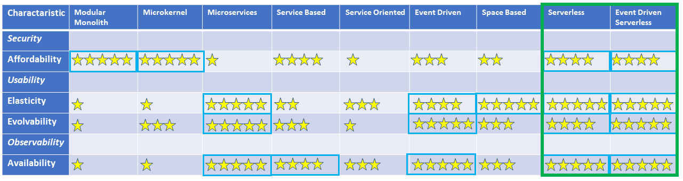
Where we started
Establish
Skills, specialties
Working patterns
Commitment
Time zones
Brainstorm

Slide 3
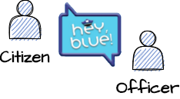

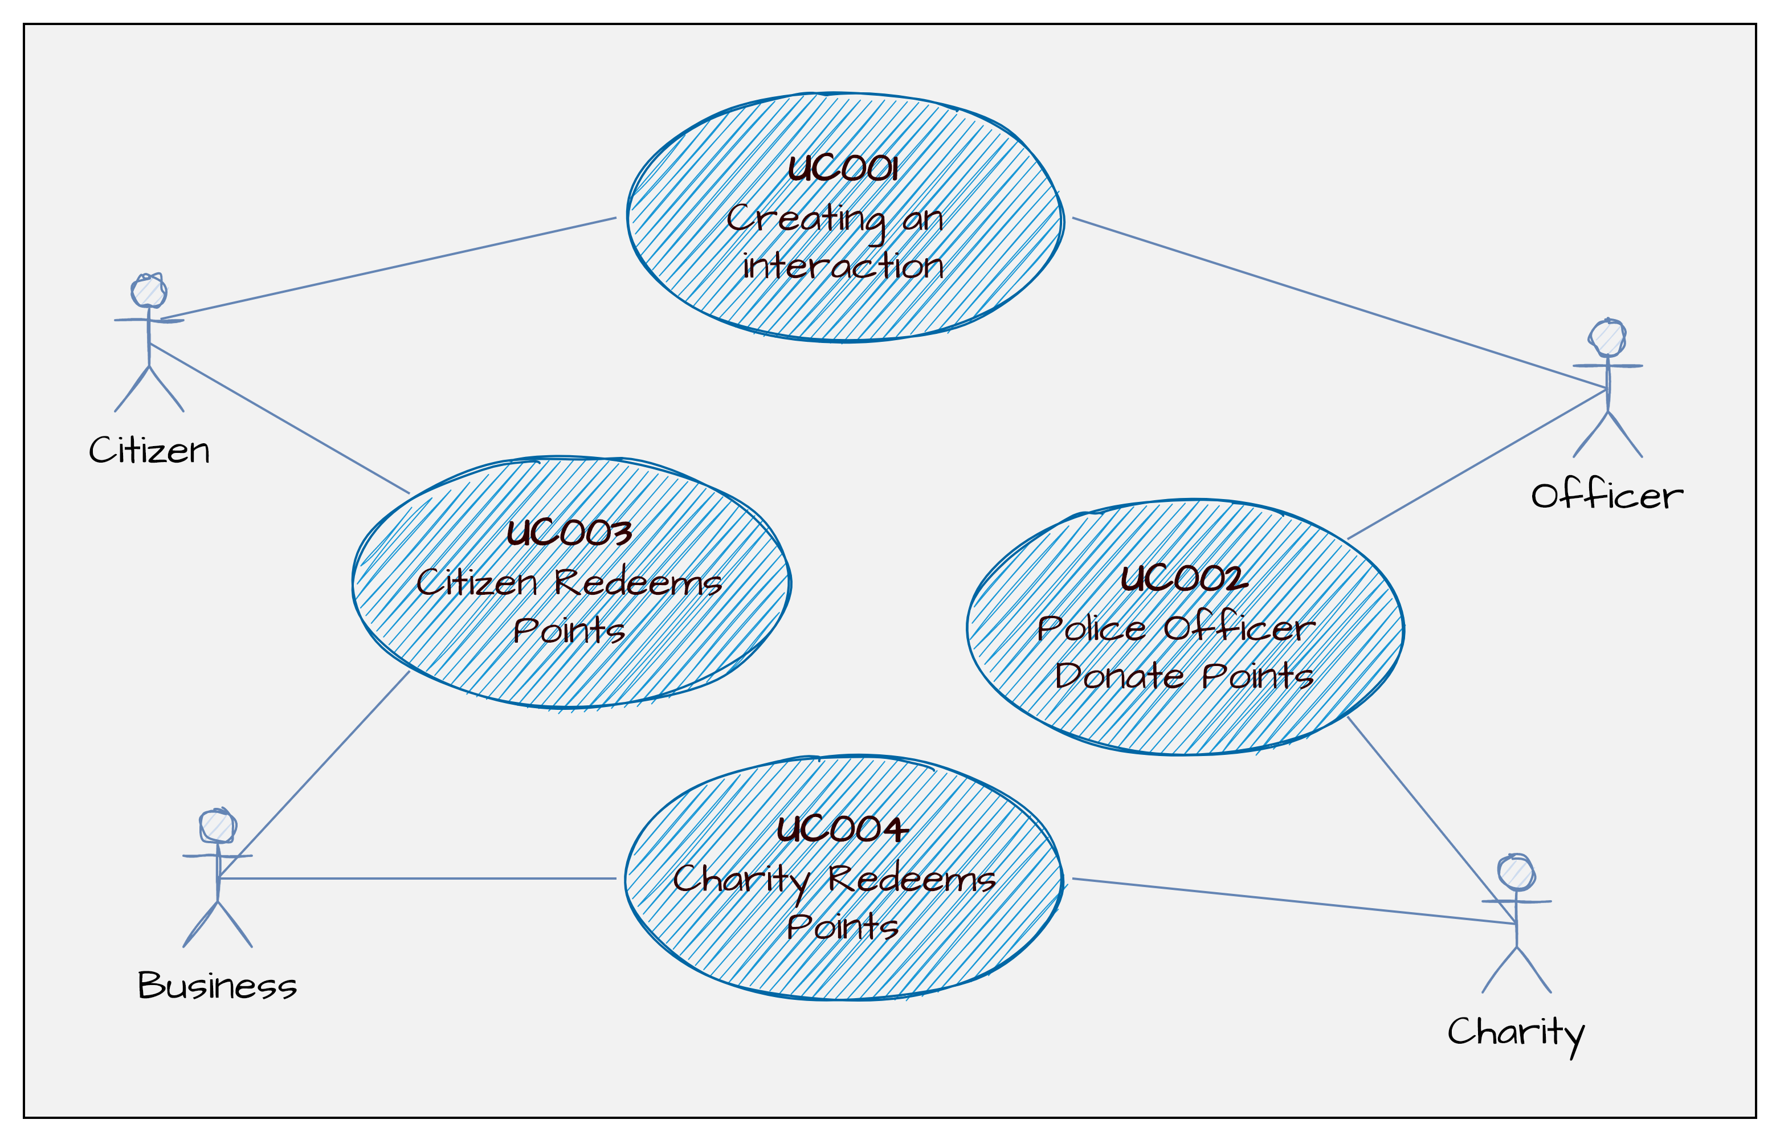
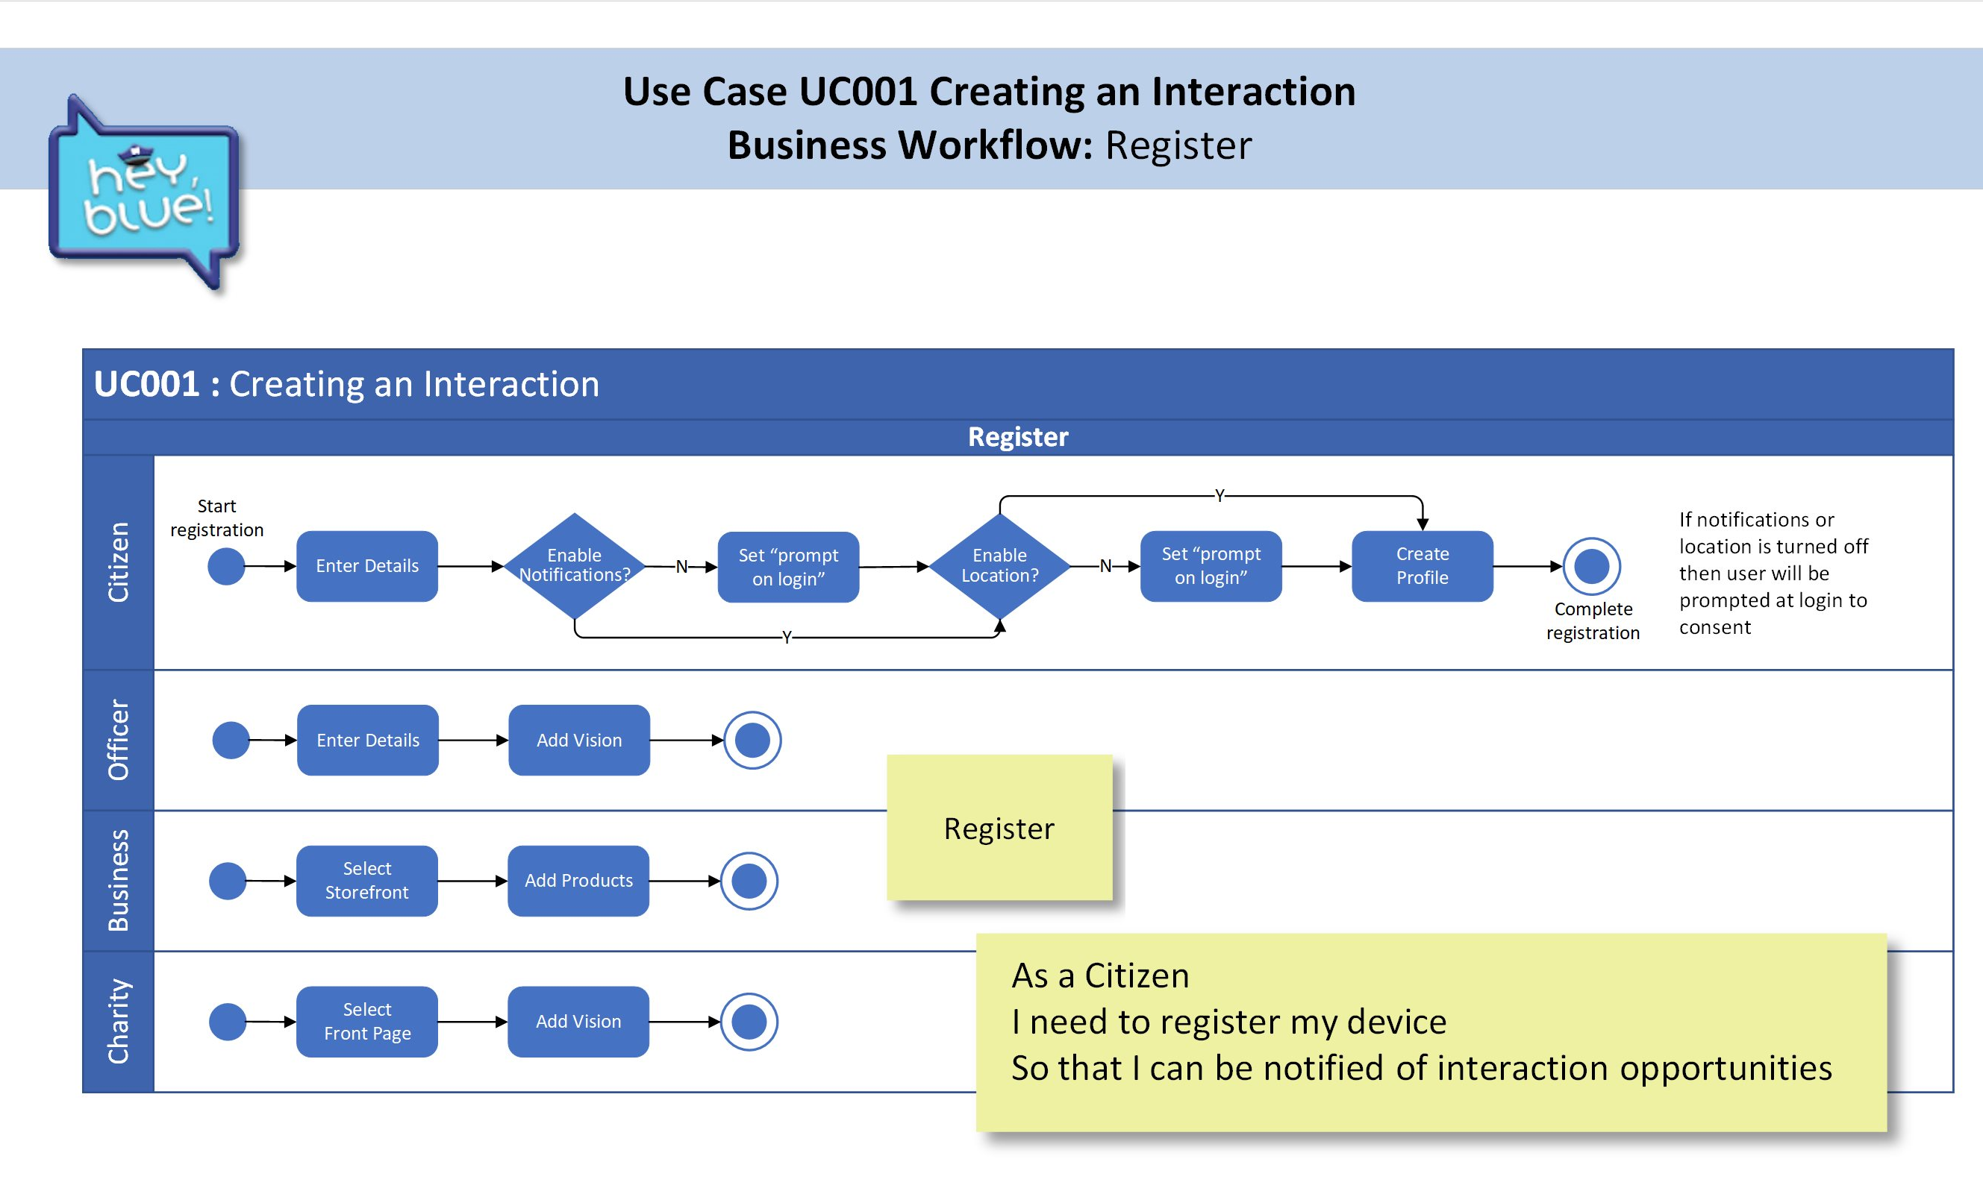

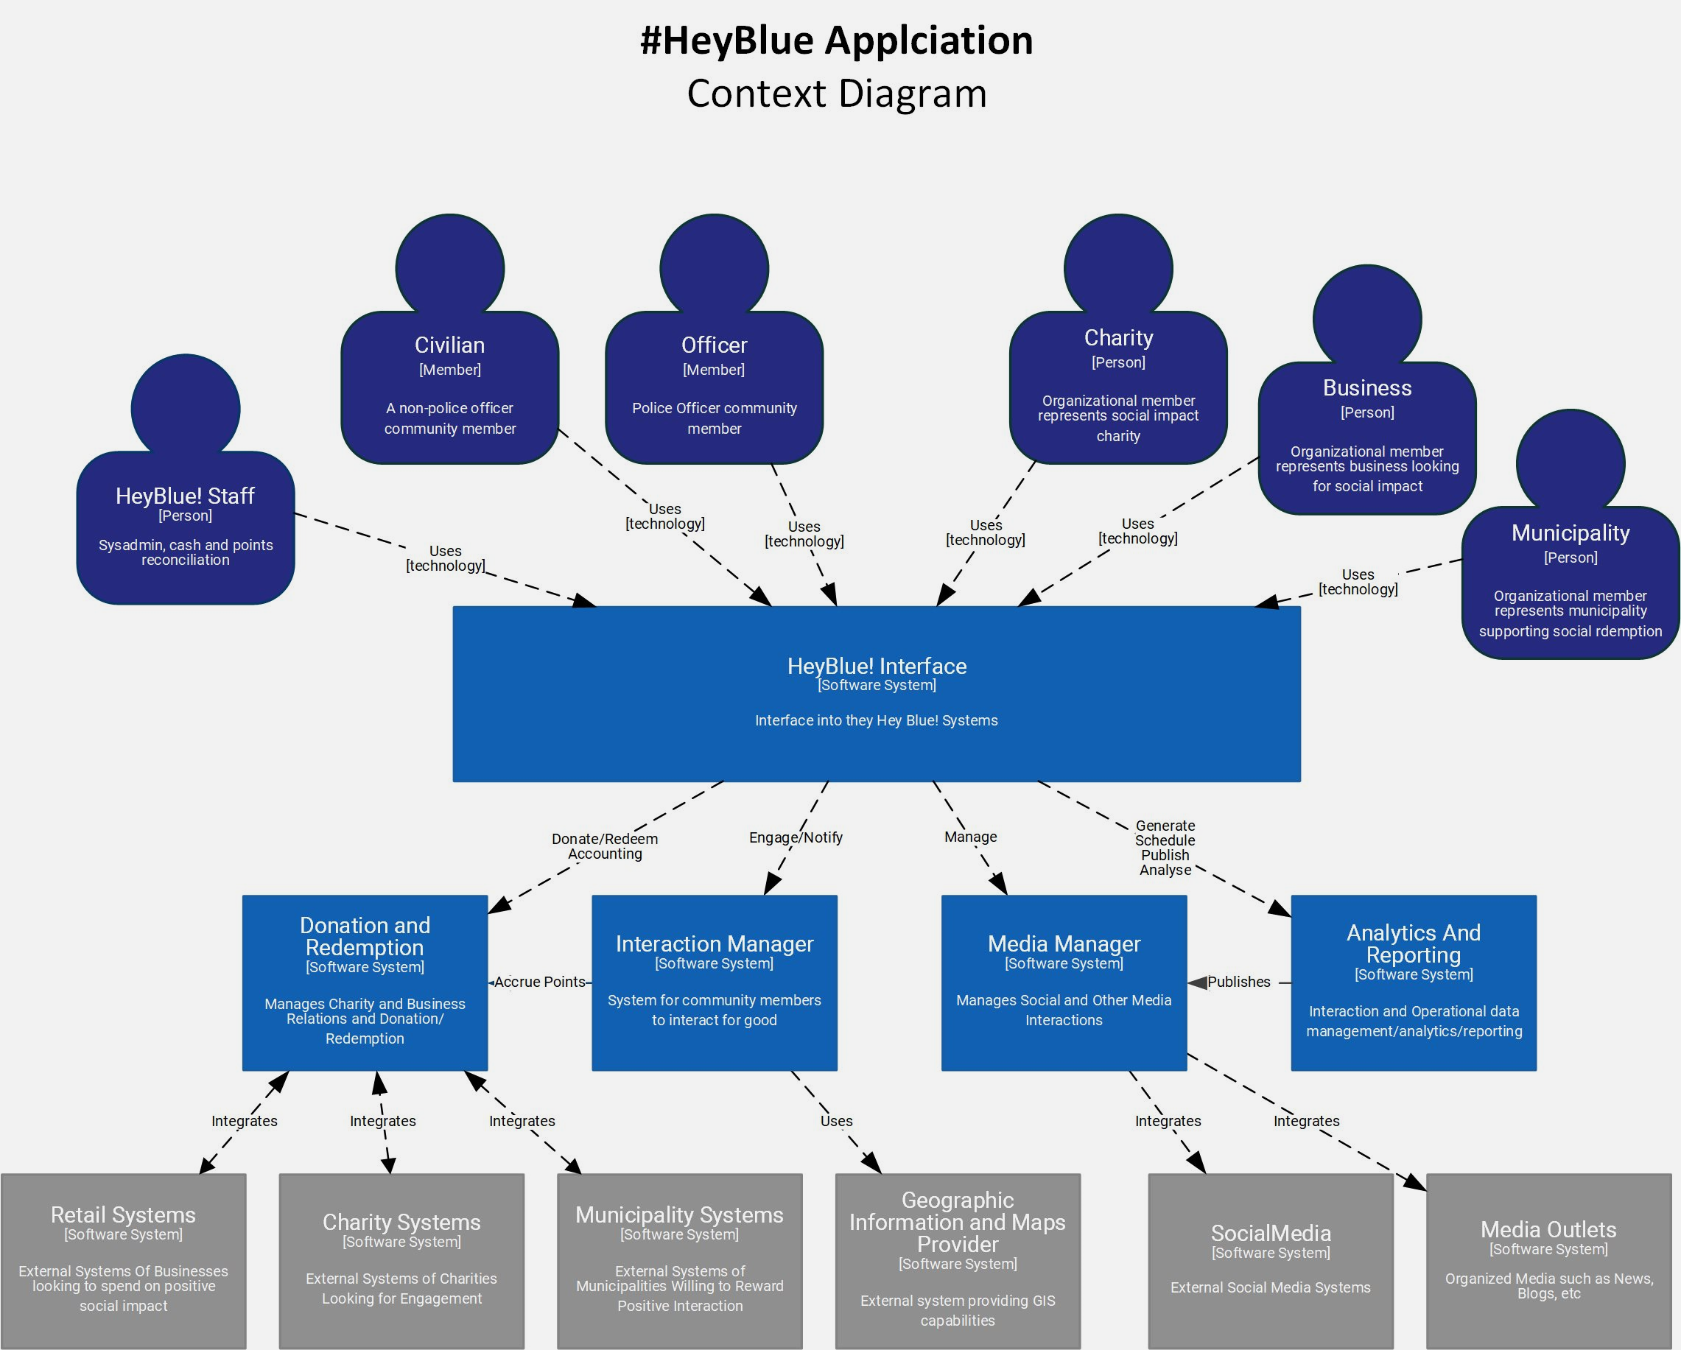
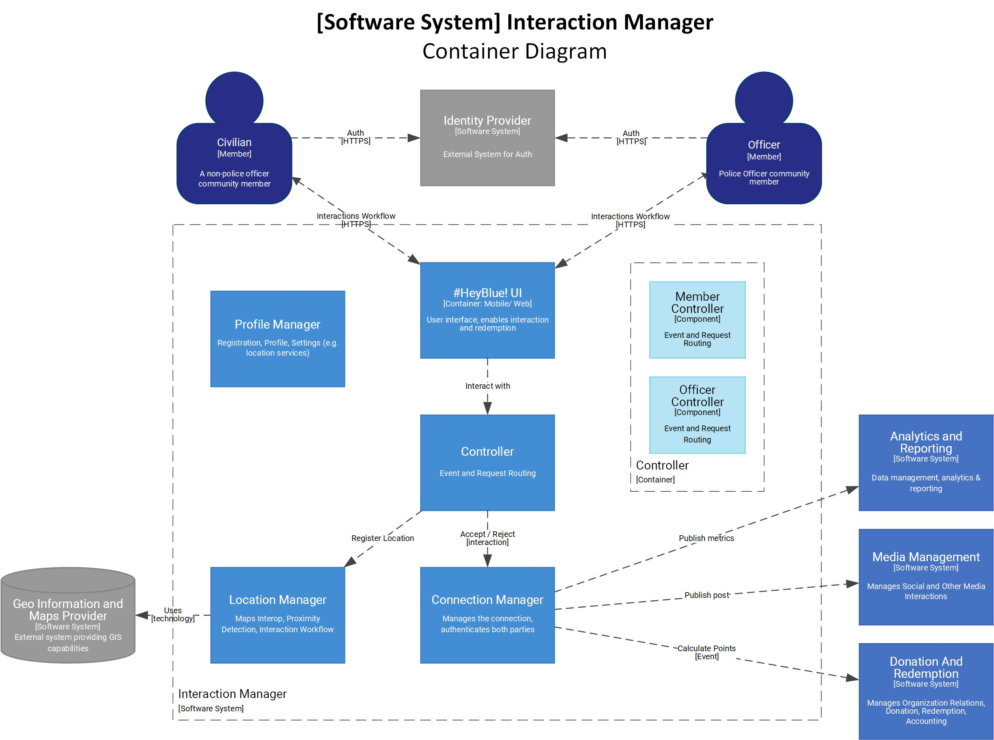
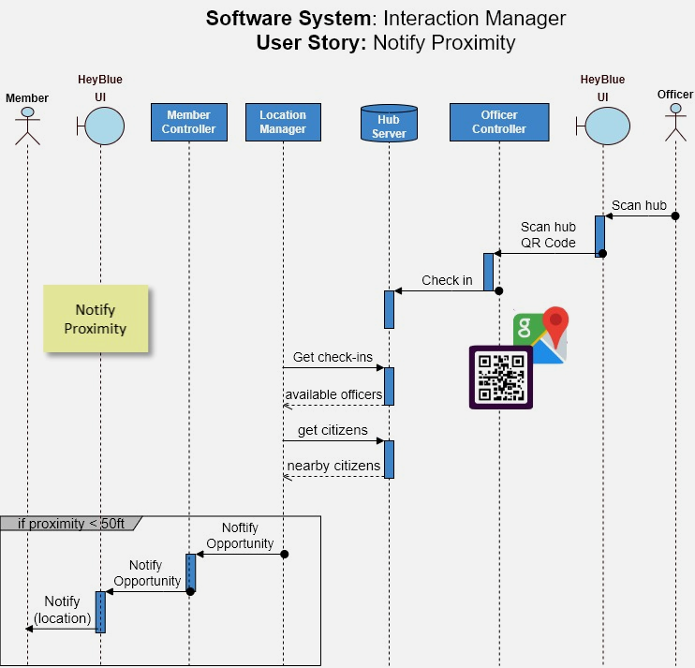
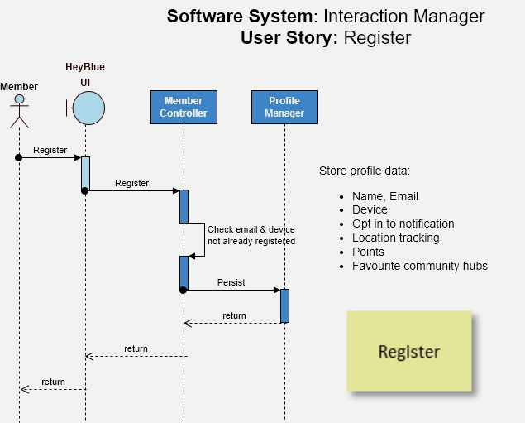
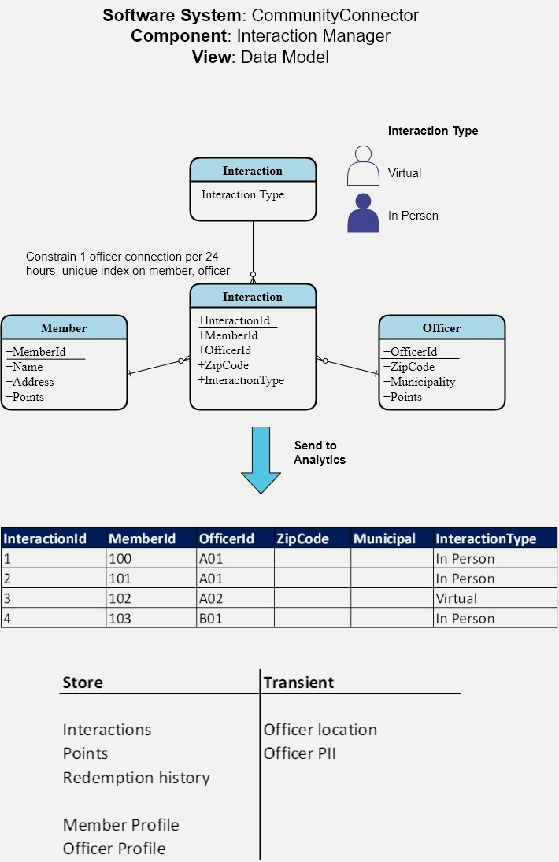
Connecting the dots with O-Reilly
Our Approach:
Straight Through Architecture
SHARI
Use cases, Process Flows (UC)
eg citizens and officers can interact
System requirements (SR)
eg the system shall notify of officer proximity
Architecture Characteristics (ADR) eg security, zero trust, officer safety
Software System (SS)
eg entity relationship, data flows
Engineering Diagrams (ED)
eg data models, sequence flows
Functional Decisions (ADR)
eg Adopt MVVM, protect location

Slide 4

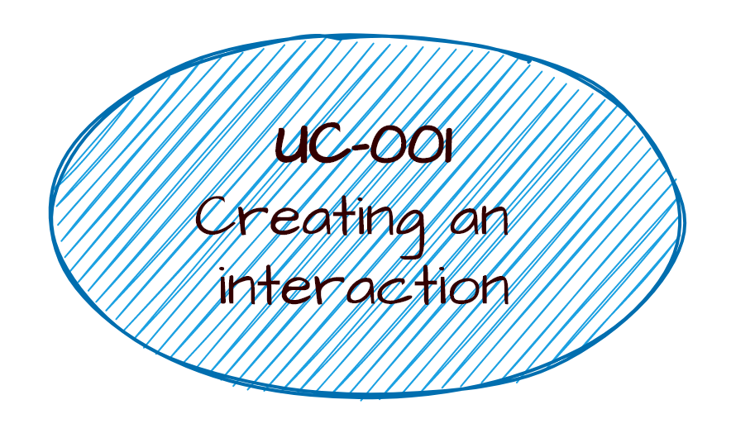
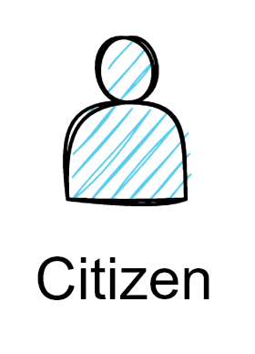
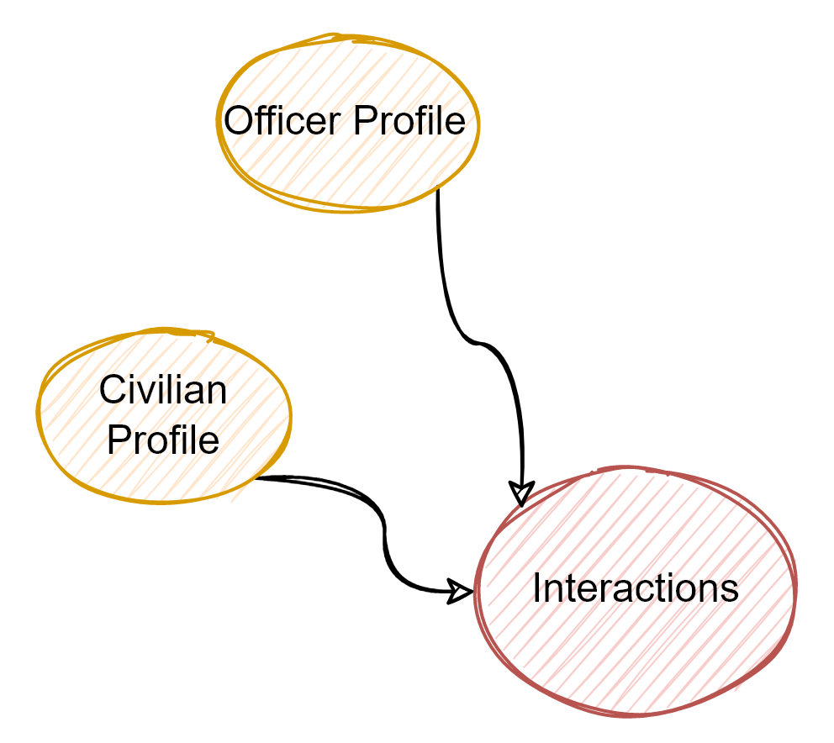
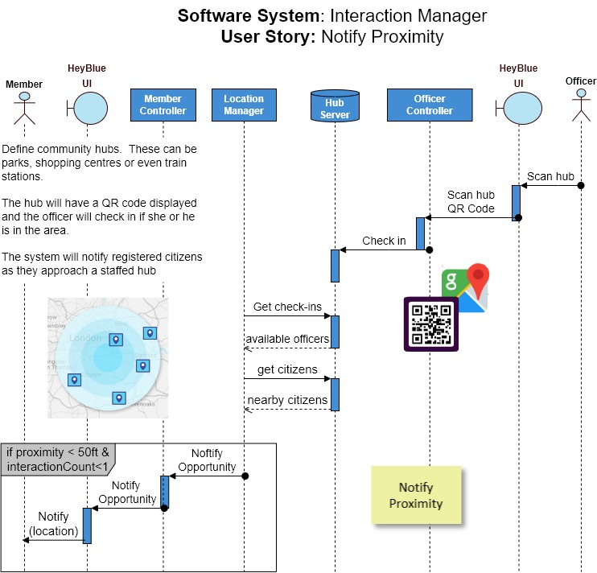

Our Approach:
Straight Through Architecture
SR-009
Officers and Citizens must have the ability to connect with each other
US-001
Register
User
UC-001 Creating an interaction
SR-009 Officers and Citizens must have the ability to connect with each other
US-001 As a user I need to be notified that an officer is available so that I can forge a community connection
ADR-009 Officer safety
SS-001 Interaction Manager
ED-002 Interaction Manager Engineering Diagrams
ADR-012 Adopt MVVM
ADR-013 Protect officer location
US-002
Notify
Proximity
ADR-003 Architecture Characteristic Security
officer safety
zero trust
Interaction Manager
non functional
ADR-016 Data Protection, delete functionality
functional
Profile Manager
User
Controller
Connection Manager
#HeyBlue! UI
Location Manager
ADR-013 Design to protect officer location

Slide 5
Deviants
We decided to significantly deviate from the face-value requirements.
We believe an architect has the responsibility to present alternatives.
Instead of a system which tracks officer location (clear security risk!) we have introduced the concept of community hubs with QR Codes representing the location. When a meet and greet opportunity arises, nearby citizens will be notified.
If the clients vehemently object, the straight through architecture approach makes it easy to change tack.

Slide 6
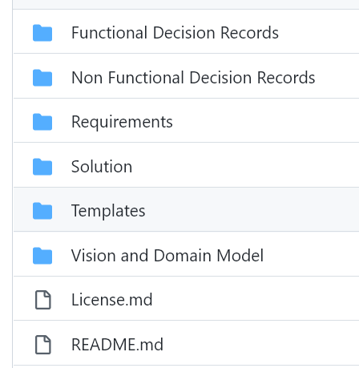
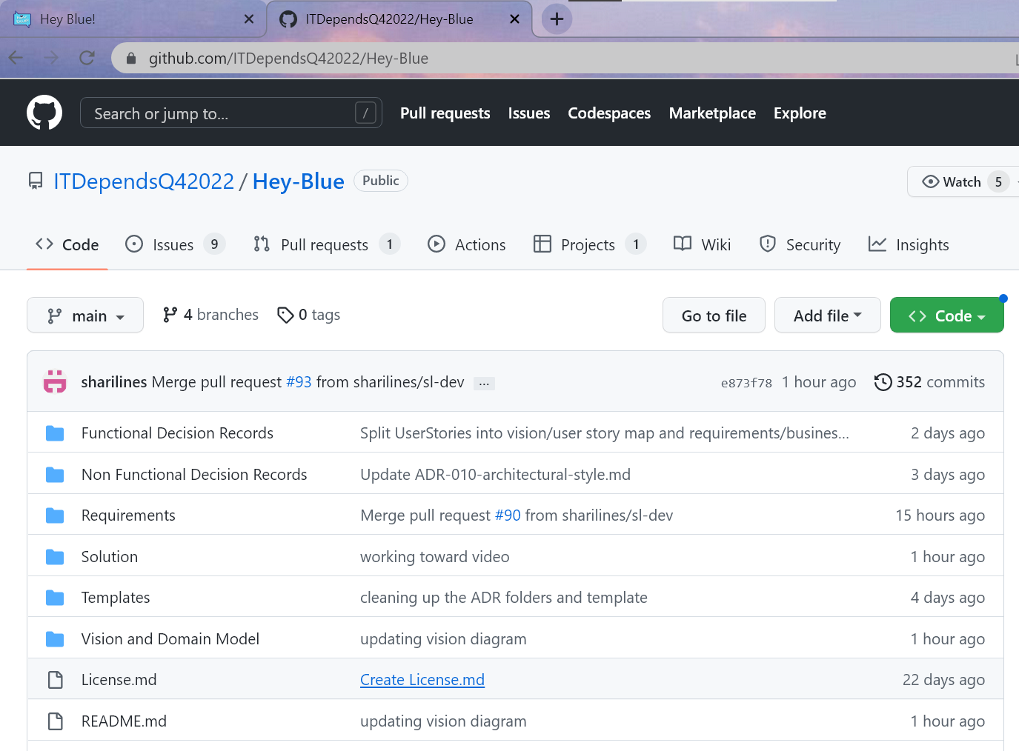
#HeyBlue
How to read

Slide 7
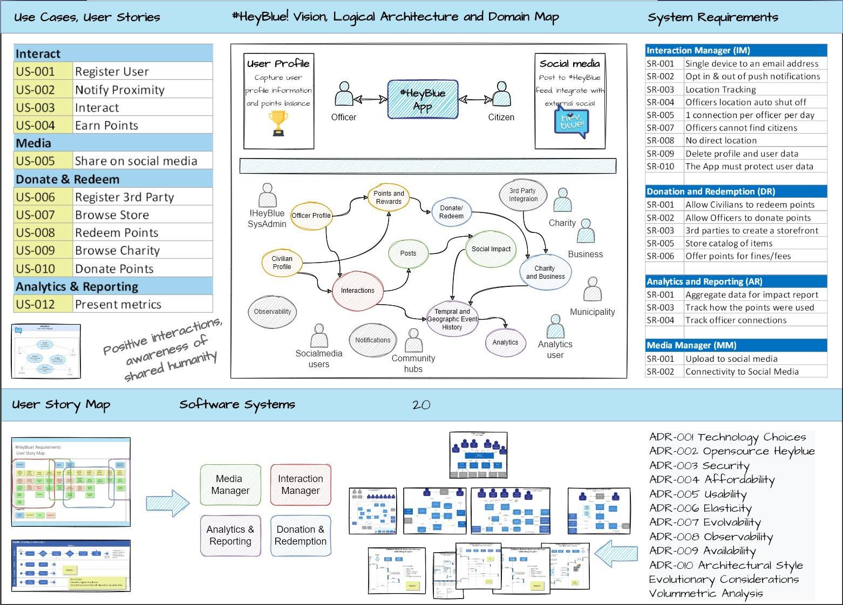

Slide 8
Domain map
MIGUEL

Slide 9

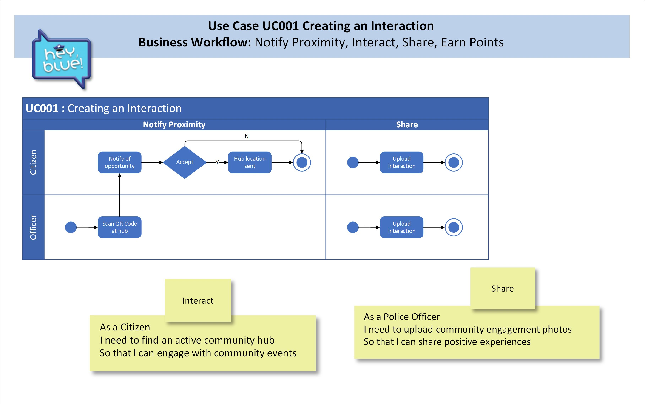
KAVYA
#HeyBlue! Requirements Use cases, system requirements
& process flow

Slide 10

#HeyBlue! Requirements User Story Map
KAVYA
Interaction
Media
Donate & Redeem
Analytics & Reporting
US-001
Register
User
US-002
Notify
Proximity
US-003
Interact
US-004 Earn Points
US-005
Share
US-006
Register
3rd Party
US-007
Browse store
US-008
Redeem Points
US-009
Browse Charities
US-010
Donate
Points
US-011
Send to analytics
Create profile for Citizen
Location Tracking
Proximity Alert
Calculate Rewards
Share to #HeyBlue feed
Business storefront
Retailer creates storefront
Spend Manager
Charity Registers
Send to charity
Store metrics
Create profile for Officer
Officer location shutoff
Option to connect
Add rewards to profile
Share to Social Media
Charity front page
Store location alerts
Update points
Present metrics
Update profile
Get Map
Manage catalog
Purchase Items
Delete profile
Legend
Activity Group
User Stories
Task
Must have

Slide 11




#HeyBlue! Requirements User Story Map
KAVYA
Software System
Analytics & Reporting
Interaction
Software System
Interaction Manager
Media
Donate & Redeem
Software System
Donation & Redemption
Analytics & Reporting
US-001
Register
User
US-002
Notify
Proximity
US-003
Interact
US-004 Earn Points
US-005
Share
US-006
Register
3rd Party
US-007
Browse store
US-008
Redeem Points
US-009
Browse Charities
US-010
Donate
Points
US-011
Send to analytics
Create profile for Citizen
Location Tracking
Proximity Alert
Calculate Rewards
Share to #HeyBlue feed
Business storefront
Retailer creates storefront
Spend Manager
Charity Registers
Send to charity
Store metrics
Create profile for Officer
Officer location shutoff
Option to connect
Add rewards to profile
Share to Social Media
Charity front page
Store location alerts
Update points
Present metrics
Update profile
Get Map
Manage catalog
Purchase Items
Delete profile
Software System
Media Manager
Legend
Activity Group
User Stories
Task
Must have

Slide 12
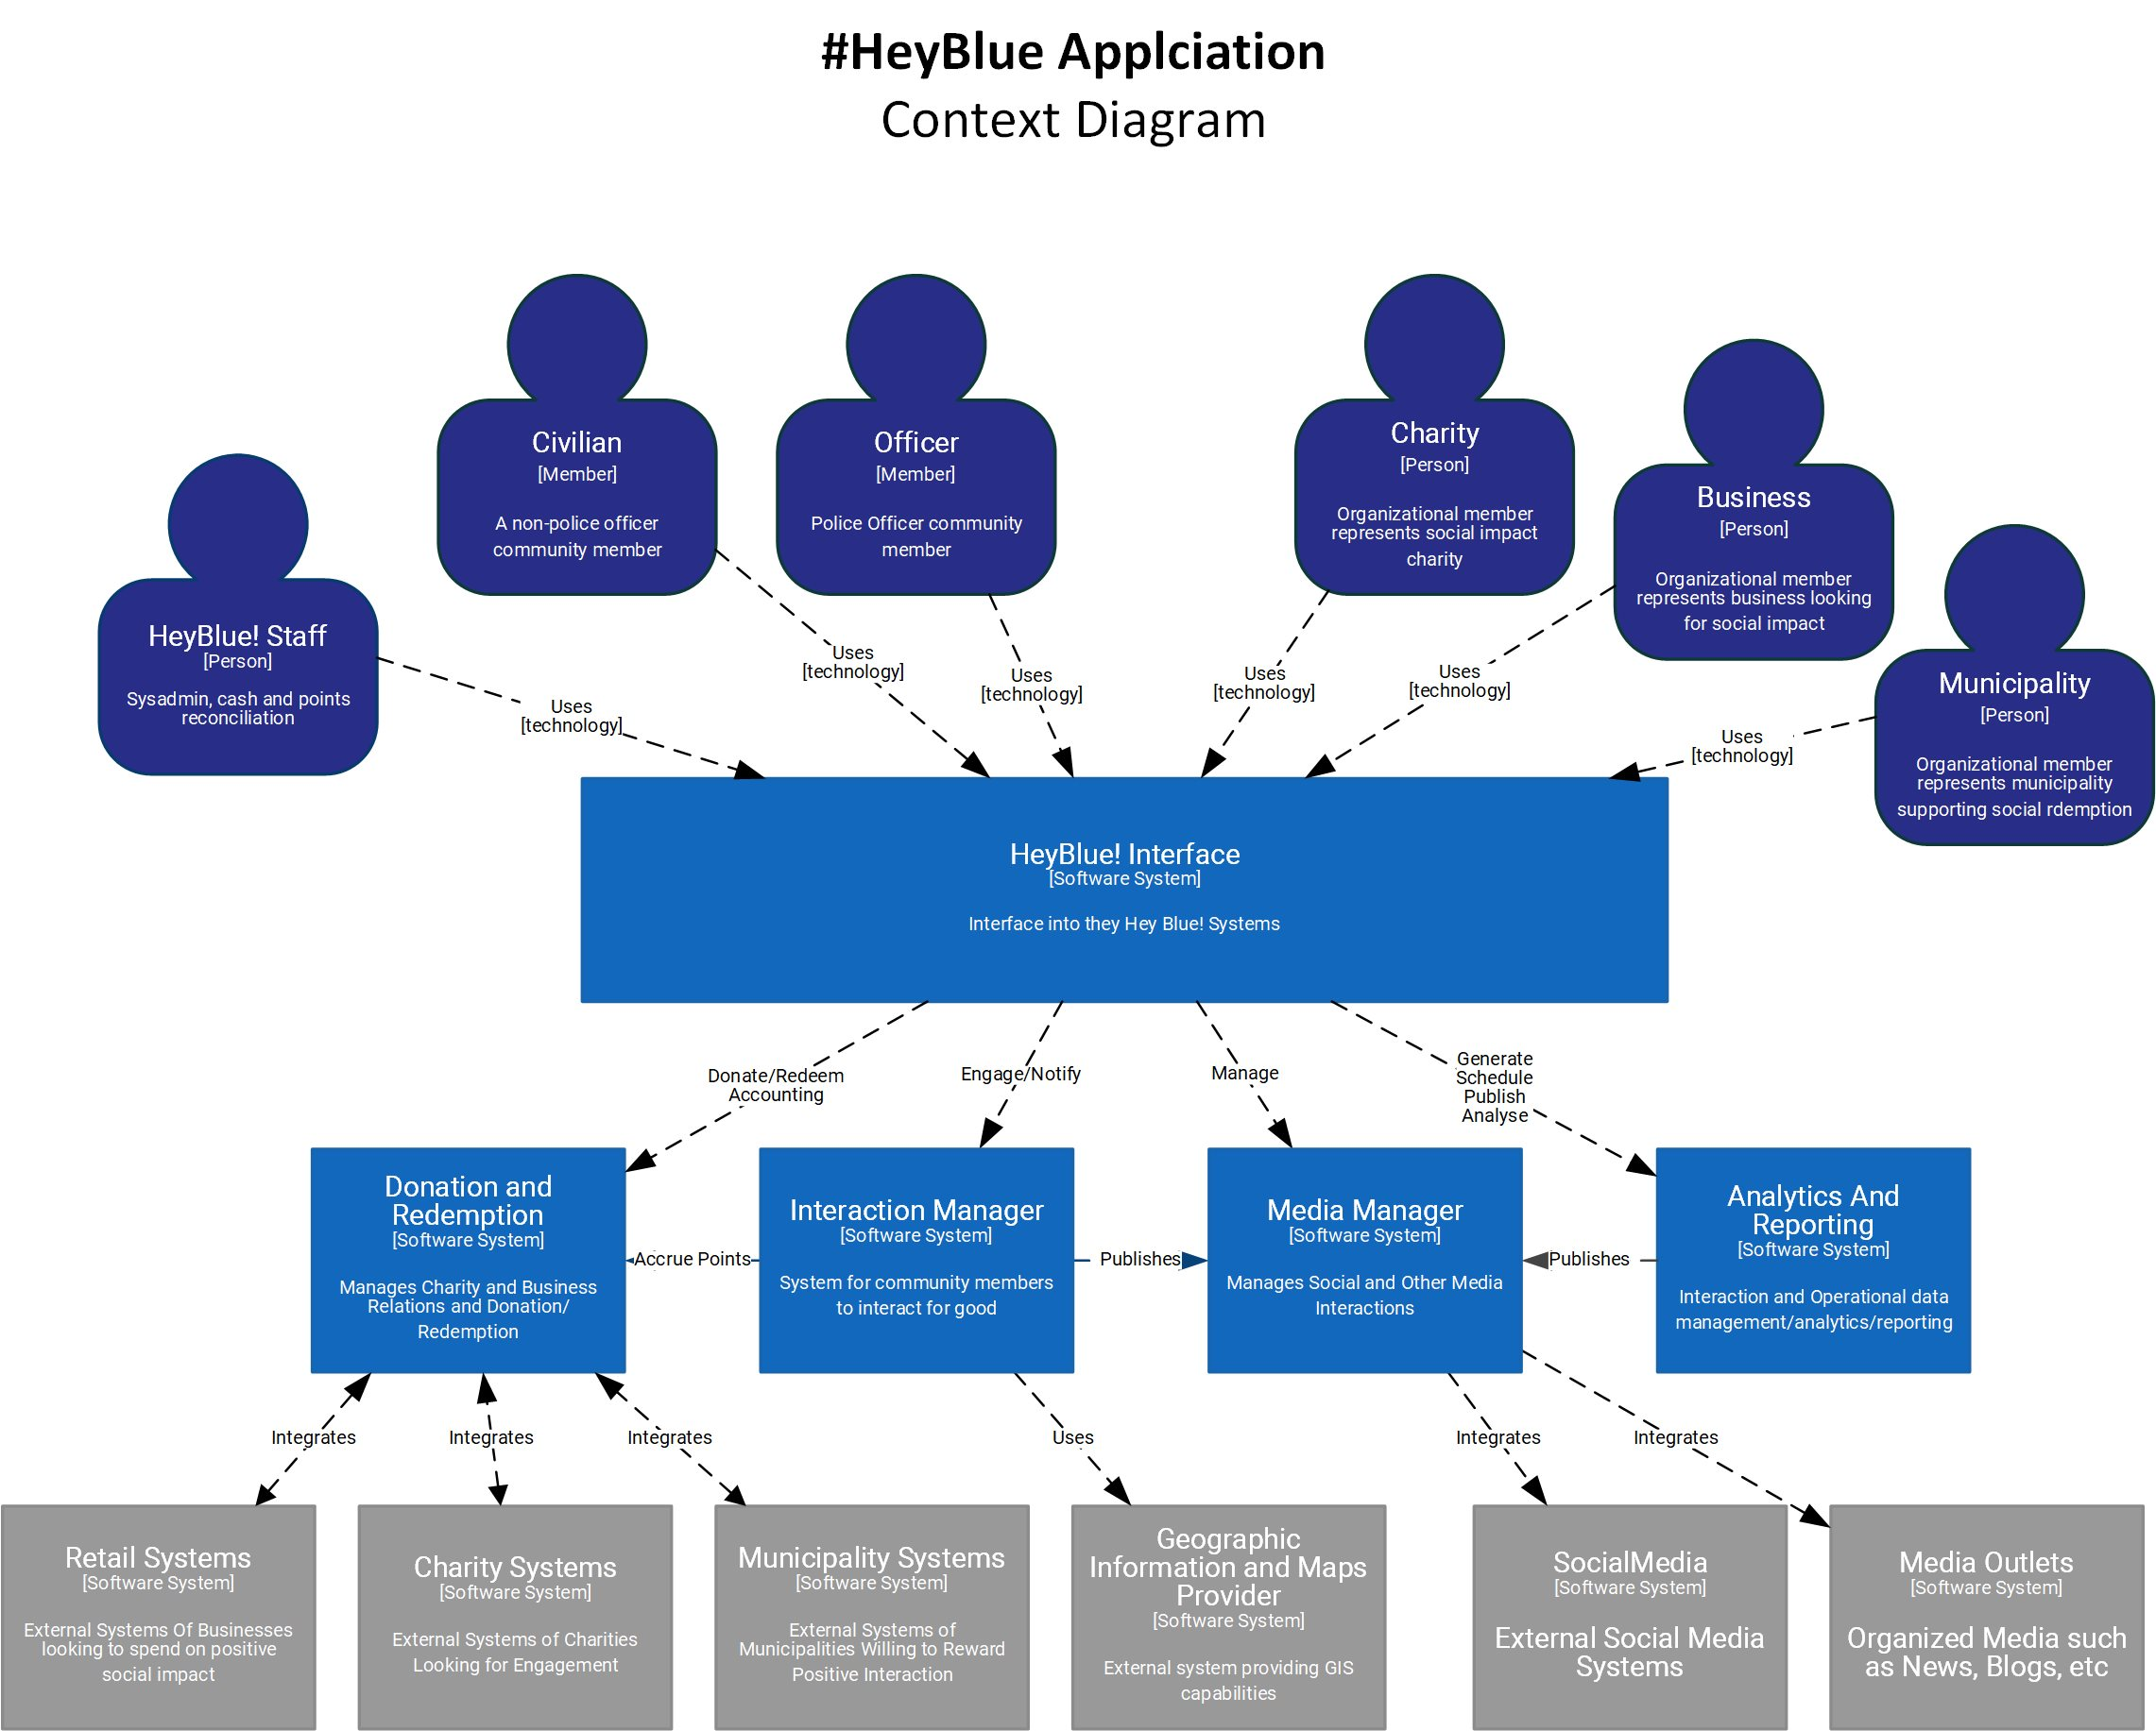
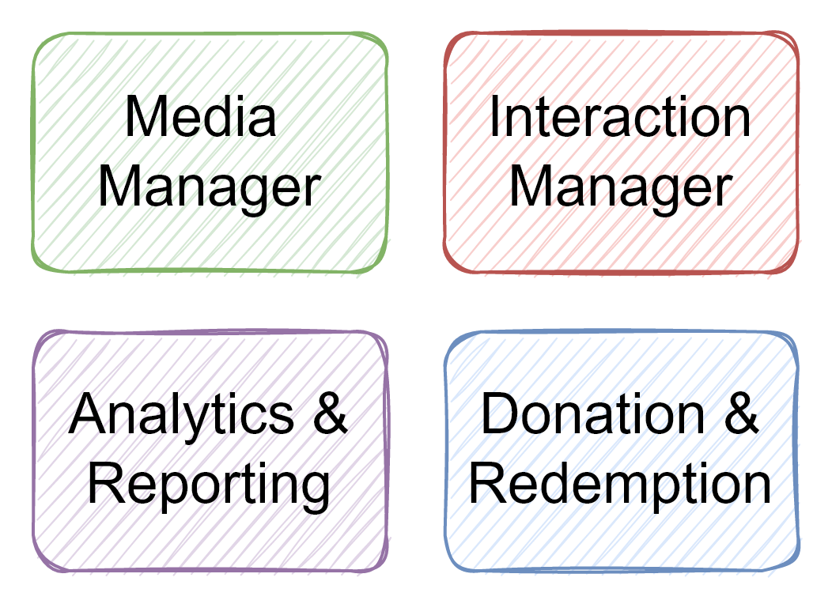

#HeyBlue! Solution
Context Diagram
MIGUEL

Slide 13
Analytics & Reporting

Slide 14
#HeyBlue! Solution
→ Interaction Manager Software System Container Diagram
Interaction Manager

Slide 15
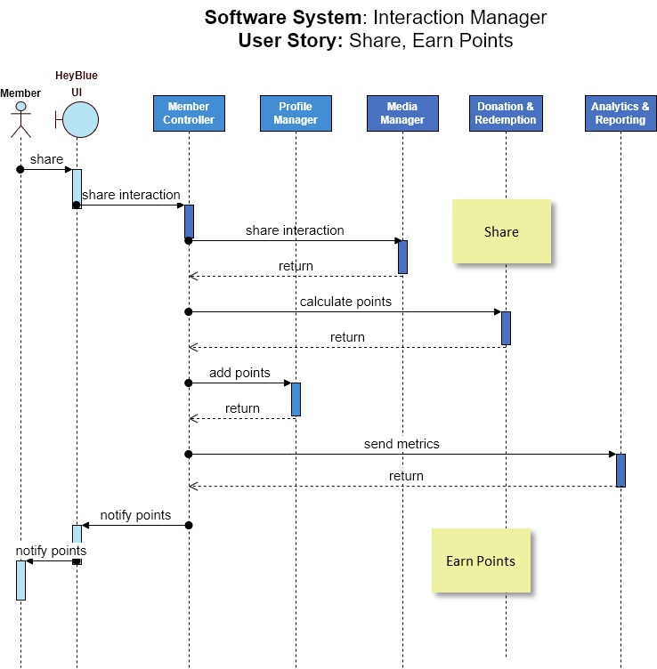
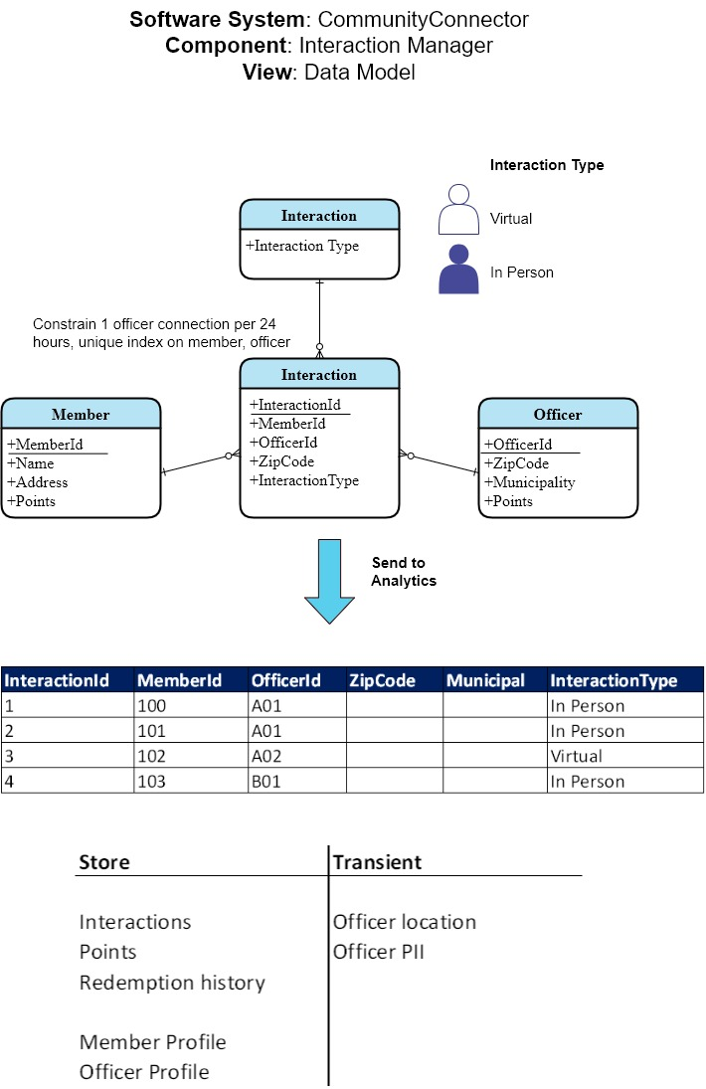
#HeyBlue! Solution
→ Interaction Manager → Detailed Design

Slide 16
Social Media Manager

Slide 17
Donation & Redemption
UMA
PRASHANT

Slide 18




Lessons learned
SHARI
Start with a structured brainstorm with the full team, starting with a use cases analysis, architecture characteristics and domain model
Jumping straight to the solution is a natural software engineering trait, do this, but iterate continuously over the requirements looking for gaps and rabbit holes (eg 1 connection/24hrs, 1 device)
Tell a story, how did you get to the solution? Look for accidental and implicitly made decisions with unintended consequences, identify and explicitly capture decisions, review and communicate with the team (eg data)
Due diligence as you go along, document, readme, diagram titles, purpose and legends.
Diagram language must be fit for purpose, for example, don’t cram every system requirement into a story and don’t model every aspect in C4
Communicate always and all the time, from commit messages to daily catchups to random 2am thoughts and ideas

Slide 19
If we were to do this internally
KAVYA
Set expectations around
Detail, container level? Code level?
Technology, agnostic/ azure?
Real use case

